Slide 1
Growing Vocabularies for
Plant Identification and Scientific Learning
DC-2005, International Conference on Dublin Core and Metadata Applications
University Carlos III of Madrid, Leganés Campus
15 September 2005
Jane Greenberg, Associate Professor, SILS, University of North Carolina at Chapel Hill (UNC-CH)
Bryan Heidorn, Associate Professor, GSLIS, University of Illinois at Urbana Champaign
Stephen Seiberling, Image Specialist, UNC Herbarium
Alan S. Weakley, Curator, UNC Herbarium

Slide 2
Overview
Motivation
Vocabulary
Plant identification
  Methods and vocabulary needs
Metadata/Vocabulary Challenges
  U-PLANT
    Research and Development
    Solutions
Conclusions

Slide 3
Motivation
World’s “rich reservoir” of primary scientific resources
Target students, enrich curricula
Web connectivity + digitization not enough
  student’s knowledge-base + vocabulary
Vocabulary gap (flowering dogwood / Cornus florida)
  Enabling technologies (OWL,RDF,…): structural solution
  Need: intellectual tasks of developing and growing vocabulary

Slide 4
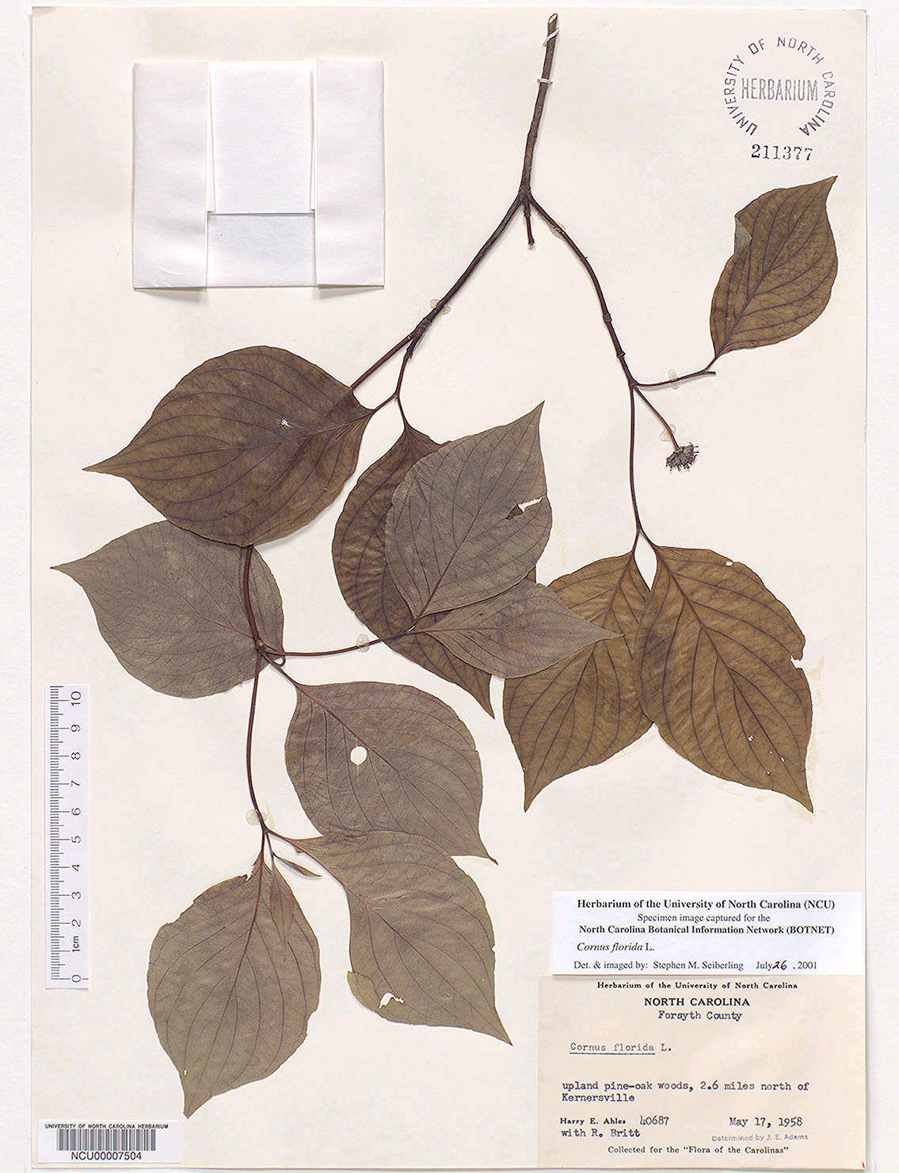
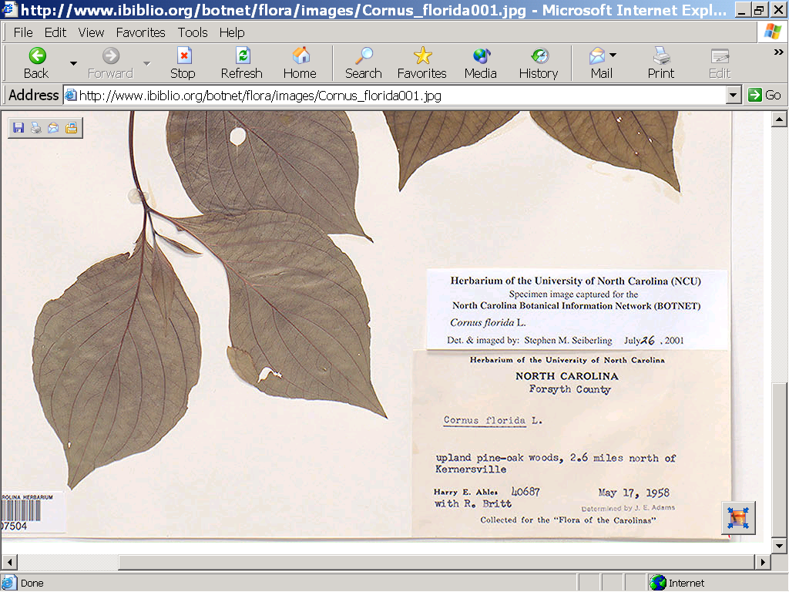
Digital Plant Specimen
Flowering Dogwood (Cornus florida)
Descriptive Label (Metadata)

Slide 5
Vocabulary is:
Key component of language; a language,
Means of communication—an ontology of sorts
Fundamental to learning and scientific advancement
Integral to the development and functionality of digital libraries
Notes:
Communication symbols, gestures, words, // in metadata community concerned w/ WORDS used to express concepts
the main ingredient of language

Slide 6
Plant Identification
Plant ID (identification)
  Most advanced living organisms, evolutionary history…
  Common part of school curricula
  Methods and Vocabulary Needs
    Applications: plant keys
      Fixed structure key and a polyclave key.
    Plant taxonomy
    Descriptive vocabulary

Slide 7
Plant Keys
Fixed structure key
  Answer an ordered series of questions, typically in the form of “either/or” (dichotomous) pairs
    Alternate or opposite arrangement?
    Toothed edged or smooth?
Polyclave key
  Present user choice of plant characters/character states
  Process of elimination
    System design and metadata challenge

Slide 8
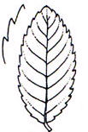
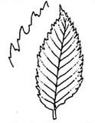
Plant Characters and Character States
Leaf shape character | Leaf margin character
Acicular Cordate Linear Needle-like | Deeply lobed Divided Doubly serrate Serrate
Serrate | Doubly serrate

Slide 9
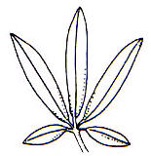
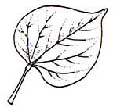
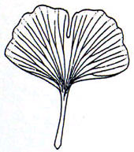
Leaf Shape
Character State Examples
Cordate
Fan-shaped
Palmate

Slide 10
Plant Taxonomy
Determine the plant’s scientific name
  species taxon / taxa levels
Carl Von Linné (Carolus Linnaeus)
Linnaean taxonomy
International Code Botanical Nomenclature (St. Louis Code) , 16th International Botanical Congress St Louis, Missouri, 1999
Vienna CODE, 2005
Taxonomic Level | Example for a Field Rose
Kingdom Phylum Class Order Family Genus Species | Eucaryota Spermatophyta Magnoliopsida Rosales Rosacaeae Rosa Rosa avensis

Slide 11
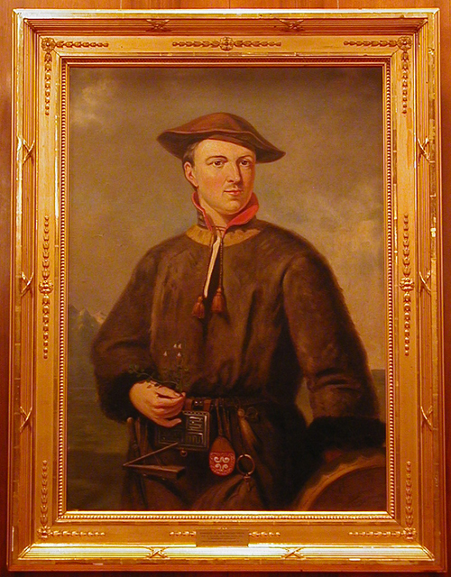
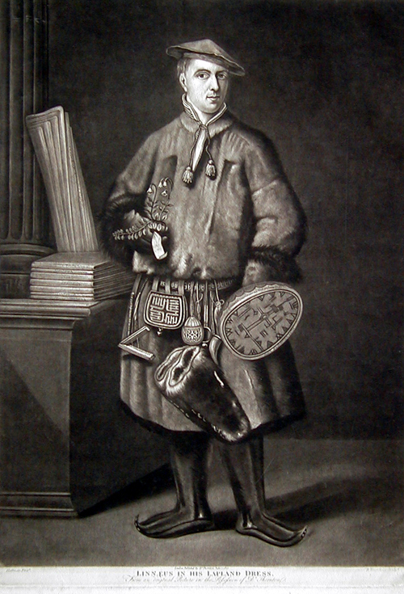
Carl Von Linné (Carolus Linnaeus)
(1707-1778)

Slide 12
Metadata / Vocabulary Challenges for Scientific Education Digital Libraries / Herbaria…
Scientific/taxonomic names (authority list)
Characters/character states (value, content vocabulary, e.g. leaf margin values)
Plant (specimen) description (container, structure, SDD [Structured Descriptive Data])
Image preservation metadata for digital specimens (date captured, resolution, size/size reduction, camera settings, etc.)
Tools to help students learn descriptive vocabulary (serrate, lobbed, etc.)

Slide 13
U-PLanT (University PLant Language Team)
BOTNET (www.ibiblio.org/botnet/flora/indexstart.html).
Plant Information Center (PIC) (www.ibiblio.org/pic)
Project OpenKey (www.ibiblio.org/openkey)
Evelyn Daniel, Professors, SILS/UNC-CH
Peter White, Professor, Botany, UNC-CH +NCBG
Ken Robertson, Botany, UIUC
Notes:
Partnership UNC SILS, UNC Herbarium, NC botanical garden, McDogel, UIUC, GSLIS

Slide 14
R&D Questions
Specific to the Student/Scientist Vocabulary Gap
What tools can help students learn botanical terminology?
What steps aid vocabulary development for plant keys, or other digital initiatives supporting plant identification?
What principles guide the development of descriptive vocabulary for plant identification?
Notes:
Put into a R&D framework, how we have addressed these vocabulary challenges

Slide 15
Research Methods and Inquiry
Vocabulary tool analysis
Expert interviews
BotNetDC and BotDC
Usability studies
FAQ analysis
Metadata creation studies

Slide 16
Development Solutions
Suite of vocabulary tools
Preliminary process model outlining vocabulary development
Identification of guiding principles for vocabulary development

Slide 17
Suite of Vocabulary Tools
Technical Plant Glossary
Student Botanical Dictionary
Conceptual Table of Descriptive Vocabulary
  200 characters and over 2000+ character states
Botanical Dictionary
UNC-OpenKey Glossary of Botanical Terms

Slide 18
Botanical Dictionary Term Entries and Bibliographic Citation
Botany: The scientific study of plants.
Pollen: Minute grains, usually powdery, containing the male sex cells of gymnosperms and flowering plants. [GT]
---------------------------------------------------------
*[GT] noted the bibliographic source: Greenway, Theresa. (2000). The Plant Kingdom: A Guide to Plant Classification and Biodiversity. Texas: Steck-Vaughn Company.
Notes:
--not limited to these – like the definition, there are many different representation/structures for ontologies
--not same terminology – sometimes entities and relationships called frames and slots

Slide 19
Entry example from OpenKey Glossary of Botanical Terms
Term- [Botanical structure] {category of application} Definition. (Terms for comparison.) [source reference]
---------------------------------------------------------
Acicular- [Leaflets, Leaves] {shape} Very long and slender, gradually tapering to a point, like a needle; needle-shaped. (Compare with awl-shaped, filiform and linear.) [modified from K&P, p. 11].
Notes:
--not limited to these – like the definition, there are many different representation/structures for ontologies
--not same terminology – sometimes entities and relationships called frames and slots

Slide 20
Preliminary Process Model
1. Identify
        2. Evaluate
        3. Modify
        4. Transform
        5. Implement
        6. Test/Evaluate
        7. Revise
Notes:
U-PLanT’s vocabulary development activities have been extensive, and also expedient in an effort to complete project deliverables

Slide 21
Guiding Principles for Descriptive Vocabulary Development
Understandability
Uniqueness
Consistency
Notes:
--not limited to these – like the definition, there are many different representation/structures for ontologies
--not same terminology – sometimes entities and relationships called frames and slots

Slide 22
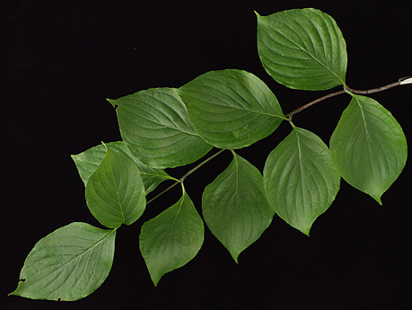
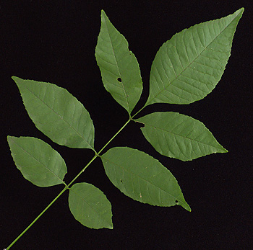
Understandability
Leaf complexity
  “Simple,” Flowering Dogwood
  “Compound,” Green Ash
Notes:
--an agent using a particular model will only be able to perceive that part of the world that his/her ontology is able to represent.
--only things in the ontology can exist for the agent
--in that way, an ontology becomes the basic level of knowledge representation scheme
--for example, the LCSH ontology doesn’t give examples for certain concepts, I.e. “women in suburbia who aren’t supposed to work, unpaid work, and housework”
--thus, in the LC world, since they aren’t defined concepts, doesn’t exist!!

Slide 23
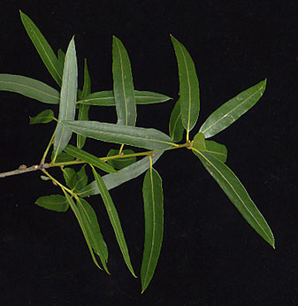
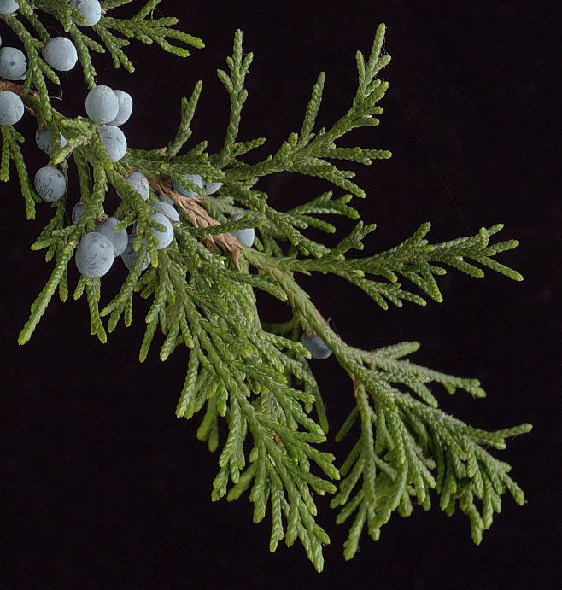
Unique: Unambiguous and Discreet
Leaf Duration
  “Deciduous,” Flowering Dogwood
  “Evergreen,” Eastern Red Cedar
  “Semi-evergreen,” Willow Oak

Slide 24
Conclusions
Guide vocabulary development for plant keys, or other digital initiatives facilitating plant identification
Process model and principles may inform descriptive vocabulary development other disciplines with same challenges and goals
Baseline for conducting more research

Slide 25
Future Research
Study the discipline of botany through selected laws of distribution (e.g.,Zipf’s law and Bradford’s law) to better understand the domain and characters of North Carolina Trees and with OpenKey also Illinois prairie plants
Conduct user studies using BOTNET, PIC, and OpenKey to test the usefulness of all the tools in the vocabulary suite.
Analyze extensibility of the Conceptual Table for additional families (both flora and fauna)

Slide 26
a closing remark…
People are increasingly calling for a single Web resource to describe all life on earth (Wilson, 2003)
  if we want to move in this direction and inform people about the natural world on a global scale and further scientific education, we need to continue to study vocabulary challenges and share our experiences

Slide 27
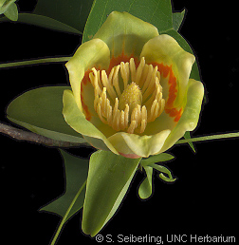
For more information on OpenKey
University of North Carolina at Chapel Hill
http://www.ibiblio.org/openkey
University of Illinois at Urbana-Champaign
http://www.isrl.uiuc.edu/~openkey

